Slide 1
INDIAN PREMIER LEAGUE
ANALYSIS AND INSIGHTS
BY K.H.S.CHAKRAVARTHY
MENTORNESS

Slide 2
INTRODUCTION
Overview: This presentation provides an in-depth analysis of the Indian Premier League (IPL) performance metrics. It includes data on runs scored, runs conceded, delivery types, and other key performance indicators.
Objective: To offer insights into player performances, team strategies, and overall trends in the IPL.

Slide 3

IPL OVERVIEW
The Indian Premier League (IPL) premier Twenty20 cricket league in India. Renowned for its high-energy matches and star-studded teams representing cities, the IPL has become a global cricketing phenomenon. With innovative formats and top international players, it blends entertainment and competition, captivating a massive fan base. The IPL has redefined modern cricket, elevating it beyond a sport to a cultural spectacle.

Slide 4

TEAM PLAYING
CHENNAI SUPER KINGS
MUMBAI INDIANS
DELHI CAPITALS
PUNJAB KINGS
GUJRAT TITANS
RAJASTHAN ROYALS
ROYAL CHALLENGERS BANGALORE
KOLKATA KNIGHT RIDERS
LUCKNOW SUPER GIANTS
SUNRISERS HYDERABAD

Slide 5
KEY INSIGHTS
Total Runs Scored by Batsmen
Total Runs Given by Bowlers
Sum Of the Wickets By Teams Played
Sum of the Runs by Teams Played
Count of winners by Teams

Slide 6

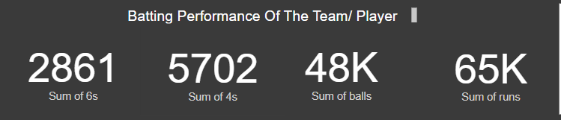
Total Runs Scored by Batsmen
Here we can see the total performance of the batsmen, like how many 6s,4s he scored and how many balls he scored to get sum of his total runs.

Slide 7
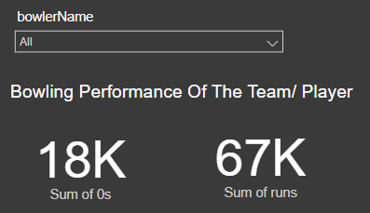
Total Performance of the Blower
The Total Performance of the blower depends upon various factors like no.of balls he bowled and no.of runs he gave and no.of runs given, so with these factors we can determine that blower is best bowler or worse

Slide 8
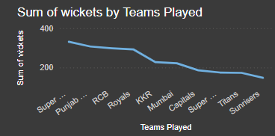
Sum Of the Wickets By Teams Played
Wickets wins the matches…
This graph tells us how the teams are taking wickets to increase the winning probability

Slide 9
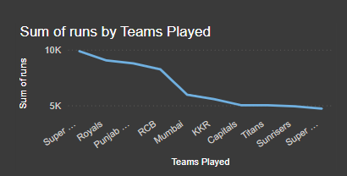
Sum of the Runs by Teams Played
The runs of the Teams Gives us a clear view about how teams are performing and which get more runs.
This gives us the detail report of which team is performing better than other team which teams top against other teams.

Slide 10
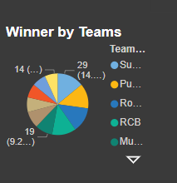
Count of winners by Teams
This PIE chart displays that winning count of each team.
From this we clearly see that Super Kings occupies 29% of winning count and stands on top.
By this top performing team and least performing team can be easily identified.

Slide 11
HANK YOU

